Slide 1



Mental Disorder Classification Using Machine Learning
Enhancing Online Behavioral Health Screening
AI-powered initial diagnosis
Leverages machine learning to predict potential mental disorders from self-reported symptoms, streamlining intake processes.
Targeted classifications
Patients categorized into Mania Bipolar, Depressive Bipolar, Major Depression, or other disorders using a 17-symptom dataset.
Efficiency for providers
Improves speed and accuracy in matching patients with appropriate care paths and therapists.
Notes:
The escalating demand for accessible and effective behavioral health services has driven the development of AI-powered screening tools. This presentation explores a machine learning-based classification model that can forecast mental disorders based on symptoms reported by patients.
Using a structured dataset containing 17 core symptoms from 120 psychology patients, the model assigns individuals to one of several predefined categories. This not only enhances diagnostic efficiency but also facilitates better therapist-patient alignment.
By automating initial assessments, providers gain a powerful ally to optimize therapeutic workflows and improve patient outcomes. This project bridges data science and mental health for scalable, ethical screening.

Slide 2



The Business Problem
Challenges in Online Behavioral Health Screening
Inefficient intake processes
Traditional systems delay diagnosis, wasting critical early intervention time.
Mismatch in therapist-patient pairing
Manual assessments often lead to suboptimal therapeutic alignment.
Need for predictive screening
A scalable, intelligent model is required to forecast disorders based on symptom data.
Notes:
As behavioral healthcare shifts online, outdated intake processes have become a bottleneck. Manual assessments are slow and often result in mismatches between patients and therapists, compromising care quality.
In response, there is a growing demand for tools that not only speed up the intake process but also improve its accuracy. A predictive model that can analyze symptom data and provide immediate diagnostic guidance could dramatically enhance care delivery.
By tackling inefficiencies and empowering practitioners with actionable insights, this project aims to make mental health support more responsive and patient-centric.

Slide 3

Background & Industry Context
AI’s Rising Role in Behavioral Healthcare
Telehealth surge: Demand for online mental health services spiked due to global health crises and digital transformation.
AI as a disruptor: Machine learning is revolutionizing patient intake, diagnosis, and care pathways in behavioral health.
From reactive to proactive care: Data-driven tools enable early detection and preventative interventions before symptoms escalate.
Photo by Hitesh Choudhary on Unsplash
Notes:
Even before the recent global health crisis, behavioral health was increasingly moving online. The pandemic drastically accelerated this trend, making telehealth the new norm for many therapy practices.
Artificial Intelligence has emerged as a critical innovation driver, transforming traditional models of patient engagement and diagnosis. Through machine learning, mental health platforms can now provide faster, data-informed decisions and elevate the quality of care.
This shift empowers clinicians with tools to proactively address patient needs—identifying issues earlier and tailoring treatments with greater precision. As we embrace digital psychiatry, AI becomes a pivotal ally in shaping the future of mental wellness.

Slide 4



Dataset & Symptom Features
Foundation for Machine Learning Classification
Rich symptom dataset
120 psychology patients evaluated based on 17 core symptoms ranging from mood swings to concentration levels.
Key symptom categories
Includes emotional (sadness, euphoria), cognitive (overthinking, concentration), and behavioral (aggression, sleep issues) traits.
Target disorders
Model distinguishes among Mania Bipolar, Depressive Bipolar, Major Depression, and other disorders.
Notes:
At the heart of the classification system lies a structured dataset sourced from Kaggle, comprising responses from 120 psychology patients. Each entry includes 17 critical symptoms used for mental health evaluation.
These symptoms capture a wide range of behavioral, emotional, and cognitive indicators—such as mood swings, sleep disorders, optimism, overthinking, and concentration issues—allowing a comprehensive profiling of patient well-being.
The model utilizes this information to classify patients into one of four possible disorder categories. This precise categorization allows for focused interventions and enhances the effectiveness of mental health treatment pathways.

Slide 5



Data Preparation & Engineering
Building a Robust ML Input Pipeline
Column refinement
Irrelevant fields like IDs and timestamps removed; renamed for clarity.
Categorical Features
All symptoms with categorical values where discretized for modeling.
Missing value handling
Dropped incomplete records to maintain dataset integrity and training stability.
Notes:
Preparing the dataset involved multiple engineering steps to ensure optimal model performance. Irrelevant or noisy data like identifiers and timestamps were eliminated, and columns were cleaned and renamed for clarity.
Using Spark ML’s VectorAssembler, the various symptom features were combined into a single feature vector—a format required by most machine learning algorithms. This vectorization step ensures uniformity and enables effective model training.
Additionally, rows containing missing values were removed to avoid introducing bias or instability into the model. These preprocessing steps are foundational in constructing a clean, reliable pipeline for mental health prediction.

Slide 6



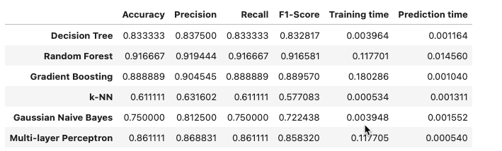
Machine Learning Methods
Classification Strategy Using Spark ML
Supervised learning
Labeled training data enables the model to learn mappings from symptoms to disorder classes.
SciKit Learn pipeline
Preprocessing, feature engineering, and modeling performed using SciKitLeaern’s scalable tools.
Random Forest algorithm
Chosen for its robustness, low overfitting risk, and accuracy on high-dimensional data.
Notes:
The classification task is implemented using a supervised machine learning approach. By training the model on labeled patient data, it learns to associate symptom patterns with specific mental disorders.
To ensure scalability and modularity, the pipeline is built using Spark ML. This framework streamlines preprocessing steps, from encoding categorical variables to assembling features and training the model.
The Random Forest Classifier was selected due to its high accuracy, ability to handle many input variables, and resilience against overfitting. Its ensemble-based nature allows it to provide stable, interpretable predictions—making it well-suited for behavioral health applications.

Slide 7



Model Evaluation & Random Forest Justification
Comparing Classifier Performance Metrics
Accuracy comparison
Random Forest outperformed Logistic Regression, Decision Tree, and MLP models on test set accuracy.
Model robustness
Random Forest resists overfitting and generalizes well across unseen data.
Feature importance insight
Allows interpretability by ranking symptom influence on predictions.
Notes:
After training several classifiers on the prepared dataset, the Random Forest model emerged as the best performer in terms of accuracy. It consistently outperformed alternatives such as Logistic Regression, Decision Trees, and MLP Classifiers.
Random Forest’s ensemble structure provides strong resistance to overfitting, making it more reliable for real-world applications. Its ability to handle noisy and high-dimensional data gives it an edge in behavioral health, where symptom variability is significant.
Moreover, it offers insights into feature importance—highlighting which symptoms most influence the model’s decision. This transparency is crucial for building trust in AI systems, particularly in sensitive fields like mental healthcare.

Slide 8
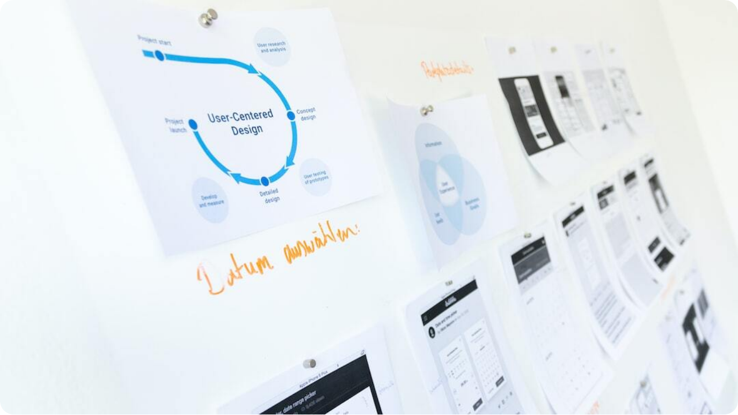
System Implementation Plan
From Ingestion to Prediction and Feedback
Data pipeline: Automated intake of patient self-reports from online forms into secure storage.
Inference engine: Deployed ML model processes data in real-time to predict mental disorders.
Feedback loop: Therapist diagnoses fed back into the system to retrain and refine model accuracy.
Photo by NEW DATA SERVICES on Unsplash
Notes:
Implementing the AI-powered screening tool involves building a streamlined and secure infrastructure. First, patient-reported data is automatically collected through digital intake forms and securely ingested into the system.
The model, hosted within an inference engine, processes this input in real-time to deliver disorder predictions. These predictions are shared with both the patient and intake staff, enhancing triage decisions.
A critical feature is the continuous feedback loop: therapists’ professional diagnoses are logged and fed back into the model. This enables iterative retraining and boosts the long-term accuracy and relevance of the tool—ensuring it evolves with clinical practice.

Slide 9


Limitations, Challenges, and Ethical Considerations
Addressing Risks in Mental Health AI
Data limitations
Small dataset size and static nature restrict generalizability across diverse populations.
Subjective symptom reporting
Variability in how individuals interpret and report mental health symptoms.
Ethical safeguards
Privacy, bias detection, and transparency are essential for trustworthy deployment.
Notes:
Despite promising results, the model has several limitations and ethical considerations. First, it was trained on a relatively small dataset of 120 patients, which restricts its generalizability. Real-world applications would require larger, more diverse datasets to prevent overfitting and improve fairness.
Patient self-reports are inherently subjective—terms like 'sadness' or 'euphoria' can vary widely in interpretation. This ambiguity makes consistent data collection and interpretation a challenge.
Ethically, deploying AI in mental health must prioritize privacy, consent, and compliance with laws like HIPAA. The system must include bias monitoring, anonymization protocols, and explainable AI methods to build trust with both patients and clinicians.

Slide 10

Conclusion & Future Applications
Scalable AI for Behavioral Health Innovation
Streamlined screening: The model automates initial mental health assessments for faster, data-driven triage.
Advanced deployment potential: Could enable personalized therapist matching and early intervention systems.
Continuous learning: Ongoing feedback loops improve accuracy and relevance of predictions over time.
Photo by Possessed Photography on Unsplash
Notes:
This project validates the use of AI to enhance behavioral health screening, demonstrating that machine learning models can meaningfully assist in identifying mental disorders early and accurately.
Beyond classification, the system sets the stage for broader applications like therapist matching, treatment path recommendations, trend analysis, and patient progress tracking. These capabilities make the tool a powerful asset in transforming mental healthcare delivery.
Continued data collection, external validation, and ethical safeguards will be essential for real-world deployment. The journey ahead involves scaling responsibly, refining continuously, and always placing patient well-being at the center of innovation.

